Slide 1
WIT COMP1000
Arrays
Notes:
WIT COMP1000 Computer Science I Course Material by Wentworth Institute of Technology (http://www.wit.edu/computer-science) is licensed under a Creative Commons Attribution-NonCommercial 4.0 International License (http://creativecommons.org/licenses/by-nc/4.0/). Based on a work at https://sites.google.com/site/witcomp128fall2014.

Slide 2
Arrays
An array is a list of variables of the same type, that represents a set of related values
For example, say you need to keep track of the cost of 1000 items
You could declare 1000 double variables: double cost0,cost1,cost2,cost3,…
Or you could use an array!

Slide 3
Creating Arrays
Creating an array is similar to declaring other variables, with some new Java syntax
  The new special symbols we'll be using to denote arrays are brackets []
The general idea is to create a collection of variables all of the same type in one step
Here is an example to create an array named cost that holds 1000 double values:
double[] cost = new double[1000];

Slide 4
Creating Arrays
double[] cost = new double[1000];
Start with the variable type (double, int, char, String, …) that you want to store in the array followed by []
Then comes the array name (cost, x, vals, …)
Next is the Java keyword new followed by the type again and the size of the array in brackets
  The number of elements in the array, or the total number of values that the array can hold

Slide 5
Collection of Variables
You can think of creating an array as declaring the same number of individual variables
Example declaring an array of 8 integers named counts:
This is similar to (but not exactly the same as) declaring 8 separate integers:
int[] counts = new int[8];
int counts0, counts1, counts2, counts3, counts4, counts5, counts6, counts7;

Slide 6
Accessing Array Elements
To actually use an individual element in the array, you specify the index of the element in brackets
Be careful not to confuse the two uses of brackets (creation versus use)
Example array of 15 integers named values, and setting the value at index 7 to 10:
int[] values = new int[15]; // create an array of 15 ints
values[7] = 10; // assign element 7 a value of 10

Slide 7
Arrays in Memory
Arrays are stored in memory so that all the elements in the array are sequential, in order:
int[] counts = new int[8];
counts[3] = 10;
address
value
variable
1000
0
counts[0]
1004
0
counts[1]
1008
0
counts[2]
1012
10
counts[3]
1016
0
counts[4]
1020
0
counts[5]
1024
0
counts[6]
1028
0
counts[7]
1032
1036
…

Slide 8
Array Elements and Length
Arrays start at index 0 and go through index size–1
  Use ARRAY.length to get the size of the array
Arrays do NOT start at index 1!
Array indices do not have to be hard coded, they can be any expression that evaluates to an integer
Example of initializing an array so that all elements have an initial value of 50:
double[] temperatures = new double[64];
for (int i = 0; i < temperatures.length; i++) {
temperatures[i] = 50;
}

Slide 9
Out of Bounds Errors
You always have to ensure that your program only uses valid elements/indices for an array
You can never access an index of less than 0
You can never access an index greater than or equal to the length of the array
If you try to access an element outside of the bounds of the array, Java will give you an ArrayIndexOutOfBoundsException
int[] myArray = new int[10];
myArray[0] = 5; // ok
myArray[9] = -6; // ok
myArray[-1] = 0; // out of bounds error!
myArray[10] = 3; // out of bounds error!

Slide 10
Exercise
What is the output of the below code?
int[] vals = new int[4];
vals[2] = 3;
vals[0] = 2;
vals[1] = 1;
vals[3] = vals[2];
for (int i = 0; i < vals.length; i++) {
System.out.printf("%d%n", vals[i]);
}

Slide 11
Answer
2
1
3
3

Slide 12
Exercise
Write a program that creates an array of 1000 integer values and initializes all of them to 1

Slide 13
Answer
int[] a = new int[1000];
for (int i = 0; i < a.length; i++) {
a[i] = 1;
}

Slide 14
Initializing Arrays
You can also initialize arrays when you declare them using special syntax with curly braces
Example:
Above example is equivalent to:
int[] pages = {513, 343, 279, 409, 651, 222};
int[] pages = new int[6];
pages[0] = 513;
pages[1] = 343;
pages[2] = 279;
pages[3] = 409;
pages[4] = 651;
pages[5] = 222;

Slide 15
Array Elements
You can use any one element of an array anywhere you can use a variable of the same type
  Assigning values
  In equations
  With input and output statements
  As method arguments
  …

Slide 16
Examples
public class ClassExamples {
public static void main(String[] args) {
int x;
int[] vals = new int[5];
for (int i = 0; i < vals.length; i++) {
vals[i] = i*i;
}
x = vals[4] * vals[3] + vals[1];
vals[0] = x - vals[2];
vals[2] = doSomething(vals[1], vals[3]);
for (int i = 0; i < vals.length; i++) {
System.out.printf("vals[%d]=%d%n", i, vals[i]);
}
}
public static int doSomething(int a, int b) {
return a * 10 + b;
}
}

Slide 17
Arrays as Method Arguments
Entire arrays can be passed as methods arguments
Array parameters in a method are a bit different than other parameters
  Use TYPE[] NAME to indicate the parameter is an array parameter, for example: int[] a
Important difference: any changes made to array elements in the method are permanent after the method is finished
  In other words, changes made to the array in the method are actually being made to the array in main() (or whoever called the method)
  It actually passes a reference into the method (more on this later)

Slide 18
Example
import java.util.Scanner;
public class ClassExamples {
public static void main(String[] args) {
Scanner input = new Scanner(System.in);
int[] myArray = new int[6];
System.out.printf("Enter 6 integers: ");
for (int i = 0; i < myArray.length; i++) {
myArray[i] = input.nextInt();
}
printArray(myArray);
}
public static void printArray(int[] a) {
for (int i = 0; i < a.length; i++) {
System.out.printf("%d%n", a[i]);
}
}
}

Slide 19
Another Example
import java.util.Scanner;
public class ClassExamples {
public static void main(String[] args) {
Scanner input = new Scanner(System.in);
int[] myArray = new int[6];
fillArray(input, myArray);
printArray(myArray);
}
public static void fillArray(Scanner s, int[] a) {
System.out.printf("Enter %d integers: ", a.length);
for (int i = 0; i < a.length; i++) {
a[i] = s.nextInt();
}
}
public static void printArray(int[] a) {
for (int i = 0; i < a.length; i++) {
System.out.printf("%d%n", a[i]);
}
}
}

Slide 20
Exercise
Write a method named addOne() that increments every value in an array by one. The array must be passed as an argument to addOne().

Slide 21
Answer
import java.util.Scanner;
public class ClassExamples {
public static void main(String[] args) {
Scanner input = new Scanner(System.in);
int[] myArray = new int[6];
fillArray(input, myArray);
addOne(myArray);
printArray(myArray);
}
public static void fillArray(Scanner s, int[] a) {
System.out.printf("Enter %d integers: ", a.length);
for (int i = 0; i < a.length; i++) {
a[i] = s.nextInt();
}
}
public static void addOne(int[] a) {
for (int i = 0; i < a.length; i++) {
a[i]++;
}
}
public static void printArray(int[] a) {
for (int i = 0; i < a.length; i++ ) {
System.out.printf("%d%n", a[i]);
}
}
}

Slide 22
Case Study: main
Since our first “Hello World” program we’ve seen an array being passed as a parameter to a method
  public static void main(String[] args)
In this case, the “args” parameter is an array of “arguments” being passed to the program from the command line – each is a string
These are automatically populated for you by the JVM

Slide 23
Try
public class ClassExamples {
public static void main(String[] args) {
System.out.printf("%d%n", args.length);
for (int i = 0; i < args.length; i++) {
System.out.printf("%s%n", args[i]);
}
}
}

Slide 24
Setting Program Arguments in Eclipse
Click the “Run” menu and “Run Configurations”
Find your application on the left list under “Java Application”
Click the “Arguments” tab on the right
Type some values, separated by spaces, into the “Program arguments” box
  Note these will stay until you clear them
Click the “Run” button

Slide 25
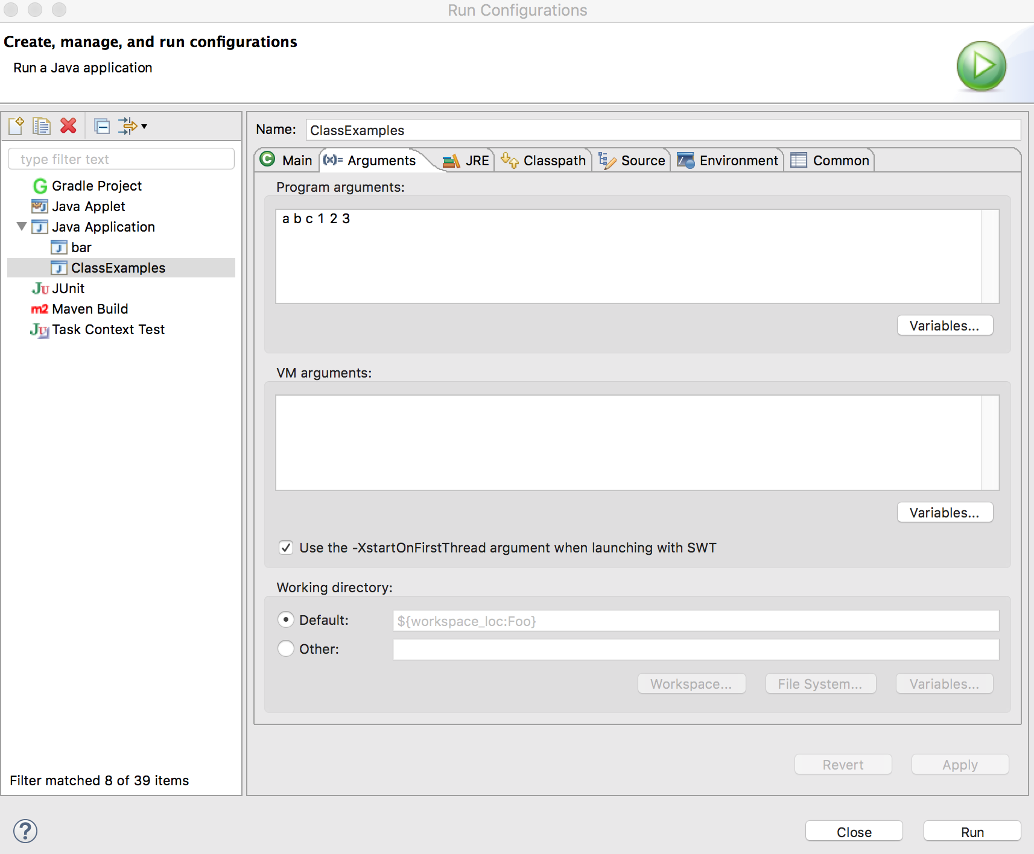
Screenshot

Slide 26
Partially Filled Arrays
Arrays do not have to be completely "full"
Every element in an array of numeric types is initialized with a value of zero at array creation time
  Other types of arrays are initialized to reasonable default values
So, you don't have to put a value into every element
Depending on your program, you will likely need to keep track of how many elements are actually used in the array

Slide 27
Example
import java.util.Scanner;
public class ClassExamples {
public static void main(String[] args) {
Scanner input = new Scanner(System.in);
int[] myArray = new int[20];
int usedSize = fillArray(input, myArray);
printArray(myArray, usedSize);
}
public static int fillArray(Scanner s, int[] a) {
System.out.printf("Enter up to %d integers (stopping with a negative value): ", a.length);
int i = 0;
int temp = s.nextInt();
while(temp >= 0 && i < a.length) {
a[i] = temp;
i++;
if (i < a.length) {
temp = s.nextInt();
}
}
return i;
}
public static void printArray(int[] a, int size) {
for (int i = 0; i < size; i++ ) {
System.out.printf("%d%n", a[i]);
}
}
}

Slide 28
Searching an Array
Sometimes you want to search an array for a particular value or target
Look through every element and return the index of one matching element (usually the first)
If no element matches the target then usually return -1, since that is never a valid index

Slide 29
Example
import java.util.Scanner;
public class ClassExamples {
public static void main(String[] args) {
Scanner input = new Scanner(System.in);
int[] values = {4, 11, -3, 0, 46, 11, 9, -77, 3, 11};
int target_value, index;
System.out.printf("Enter a value for which to search: ");
target_value = input.nextInt();
index = searchArray(values, target_value);
if (index == -1) {
System.out.printf("Target not found!%n");
} else {
System.out.printf("Target found at index %d%n", index);
}
}
public static int searchArray(int[] haystack, int needle) {
for (int i = 0; i < haystack.length; i++) {
if (haystack[i] == needle) {
return i;
}
}
return -1;
}
}

Slide 30
Take Home Points
Arrays are useful when you need to keep track of many related values
Arrays are almost always used together with loops
Array elements can be used anywhere a single variable of the same type can be used
Entire arrays can be passed to methods as array arguments
  Changes made to the array in the method affect the array in the calling method

