Slide 1
WIT COMP1000
Java Basics
Notes:
WIT COMP1000 Computer Science I Course Material by Wentworth Institute of Technology (http://www.wit.edu/computer-science) is licensed under a Creative Commons Attribution-NonCommercial 4.0 International License (http://creativecommons.org/licenses/by-nc/4.0/). Based on a work at https://sites.google.com/site/witcomp128fall2014.

Slide 2
Java Origins
Java was developed by James Gosling at Sun Microsystems in the early 1990s
It was derived largely from the C++ programming language with several enhancements
Java is a high level programming language
  Provides many useful features that make it easier to write complex code
  As opposed to low level languages that provide direct access to computer subsystems like memory but require much more care from programmers

Slide 3
Java
Like most programming languages, Java programs are written using a fixed syntax
  Syntax: a grammar that distinguished well formed statements from those that are not
Special keywords and characters are used to tell the computer how to do what you want it to do
Java forces the programmer to think as logically as the CPU
  Step-by-step, following a strict order

Slide 4
Hello World
Tells Java that this file contains executable code
public class HelloWorld {
public static void main(String[] args) {
System.out.printf("Hello World!");
}
}
"main" is where your program actually starts executing; for now simply use it to mean "start here"
Print the text "Hello World!" to the screen

Slide 5
Eclipse: New Project and Source File
File menu -> New -> Java Project
  Enter a Project name, for example: Hello World
  Click Finish
The project will show up in the left pane (Package Explorer)
Right click on the project -> New -> Class
  Enter a Name, for example: HelloWorld
  Click the button labelled public static void main(String[] args)
  Click Finish

Slide 6
Adding Code
You can add your program code in between the curly braces after the main line
For now, add the following line:
System.out.printf("Hello World!");
Note that you can ignore the line that starts with //
  Lines that start with // are comments that are ignored by the compiler

Slide 7
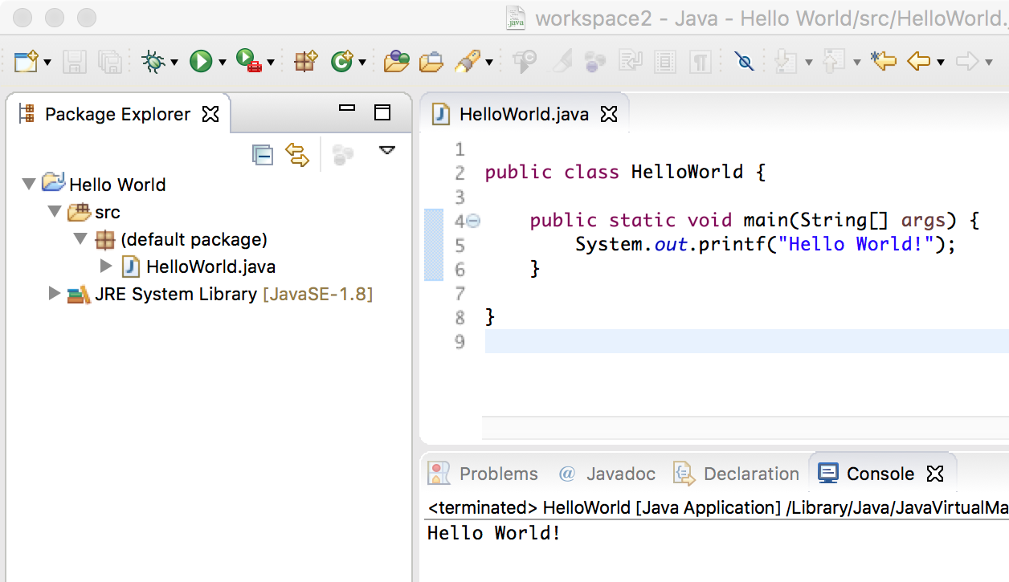
Eclipse: Running Your Program
When you are ready to test your program, you can run it directly in Eclipse
Click the Run button
  Or Run menu -> Run
  Or (Windows) Ctrl-F11
  Or (Mac) Shift-Cmd-F11
You'll be prompted to save your changes
Then you'll see your program output in the Console pane at the bottom

Slide 8
Errors
Save your work often! (Win Ctrl-s or Mac Cmd-s)
If there are any errors in your syntax you will get a message indicating it
  Normally click Cancel as there is no need to run the program if it was incorrect
Error icons show up to the left of the line numbers where the errors are detected
  Hover over the icon to get the error message
  Also, go to the bottom pane then select the Problems tab to see a list of all errors detected

Slide 9
Formatted Printing
When you want to output text to the screen for the user to see, you use: System.out.printf()
This is a built-in Java method that makes it easy to “print” a line of text to “System.out” (Java’s representation of the console)
Syntax: System.out.printf("Text");

Slide 10
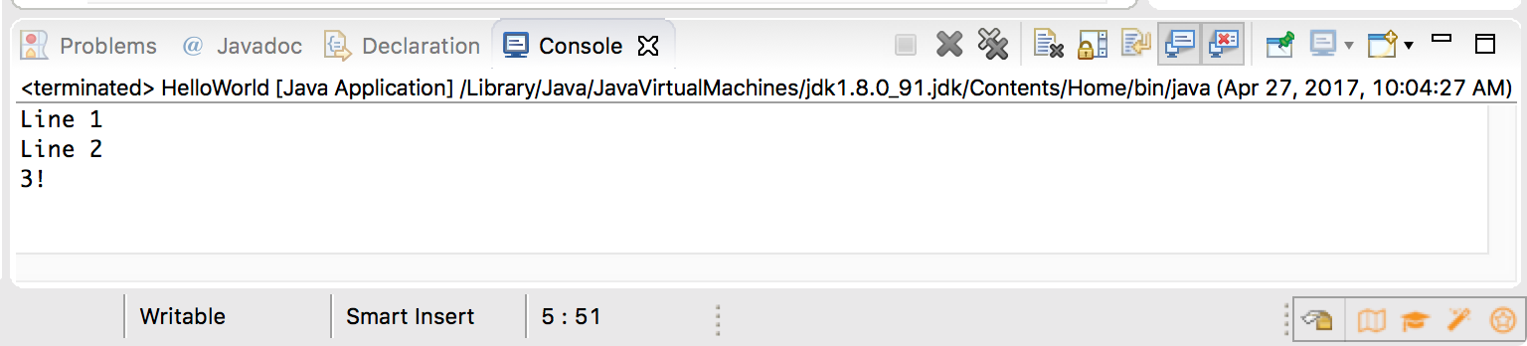
New Lines with printf()
When you want to skip to the next line, put the special %n sequence in the text – this tells Java to output the “new line” character(s)
Try:
  System.out.printf("Line 1%nLine 2%n3!%n");

Slide 11
Notes about printf()
You can insert special characters into the output by putting a backslash in front of some normal characters
  Horizontal tab: \t
  Backslash: \\
  Double quote: \"

Slide 12
Examples
System.out.printf("Hello World!");
System.out.printf("Howdy");
System.out.printf("R1C1\tR1C2%nR2C1\tR2C2%n");
System.out.printf(" /\\%n/__\\%n");
System.out.printf("System.out.printf(\"Text\");%n");

Slide 13
Variables
The first fundamental concept in programming is that of a variable
  Variables are related to mathematical variables in algebra, but work quite differently
Variables are stored in memory while the program is running
  Every variable has a value that is stored in a particular memory location
Each variable has a name that the programmer uses to access and modify that variable's value

Slide 14
Variables
Each variable holds exactly one value
Over time, as a program executes, the value of a variable can change
  This is fundamentally different from algebraic variables which are used to represent one unknown value
  Instead, programming variables store values so that we can use those values throughout a program

Slide 15
Variable Names
In Java, variable names:
  Must start with either a letter (uppercase or lowercase) or an underscore
  Must contain only letters, digits, and underscores
  Are case sensitive
Examples: count, x, userInput2, hit_points
Invalid names: 42, 5x, #yolo, file.cpp, a-b

Slide 16
Variable Declarations
Every variable must be declared before you can use it in your program
To declare a variable, you must give it a specific type:
  int: integer (whole number), positive or negative
  double: numbers with a fractional component
  boolean: boolean value (true or false)
  char: a single character

Slide 17
Variable Declarations
Syntax: TYPE NAME;
  The type comes first, then then variable name, followed by a semicolon
  The semicolon tells Java that this declaration is done, and we'll see that many Java statements need one
Examples:
  int count;
  int numVals;
  double average;
  char firstInitial;

Slide 18
Variable Initialization
Before you can use a variable, you MUST give it a value
Otherwise, your program won't know how to use the variable
  In fact, it will have a random value based on what memory looked like before, which leads to unpredictable behavior
Java will catch the error and notify you of it, but be careful of this in other languages

Slide 19
Variable Initialization
You can initialize a variable when you declare it or you can do so afterwards
Syntax after declaration: NAME = VALUE;
Syntax during declaration: TYPE NAME = VALUE;
Examples
  count = 0;
  ultimateAnswer = 42;
  int numVals = 10;
  double pi = 3.14159;

Slide 20
Example
public class HelloWorld {
public static void main(String[] args) {
int magicPoints = 100;
System.out.printf("Number of magic points: %d%n", magicPoints);
}
}

Slide 21
Printing Variables (1)
System.out.printf() is used to output the current value of one or more variable(s)
Don't put the name of the variable inside the quotes
  This is one of the most common mistakes made by new programmers
  Any non-special characters in the quotes are printed out literally

Slide 22
Printing Variables (2)
When System.out.printf() sees one of a few special characters in the quotes (e.g. %d, called a ”conversion character”), it looks to a comma-separated list after the quotes to “fill in” the corresponding variable value
System.out.printf("Number of magic points: %d%n", magicPoints);

Slide 23
Example
public class HelloWorld {
public static void main(String[] args) {
int x = 1;
int y = 2;
int z = 3;
System.out.printf("%d + %d = %d%n", x, y, z);
}
}

Slide 24
Common Conversion Characters
Integer: %d (for “decimal”, meaning base 10)
Double: %f (for “floating point”)
Character: %c
Boolean: %b
We’ll cover more details later :)

Slide 25
Example
public class HelloWorld {
public static void main(String[] args) {
int place = 1;
double avg = 3.14;
char firstInit = 'N';
boolean guilty = false;
System.out.printf("#%d, avg=%f%n", place, avg);
System.out.printf("%c is guilty: %b%n", firstInit, guilty);
}
}

Slide 26
Sequential Execution
Java programs start executing with the first line after the { after the main() line
Each line is executed in order, one after the other until you get the } after the main() line
We'll soon see how to affect this linear execution order, but even then programs execute one line at a time
You have to train yourself to think one statement at a time
  This is one of the single most important skills you can have as a novice programmer

Slide 27
Program Input
We also need a way to get user input into our programs while they are running
Java doesn't (easily) allow reading directly from System.in
Instead, you use a Scanner object that handles reading the input and ensures that the type of data you read matches what you want
  The syntax is weird at first, but you'll get use to it

Slide 28
Input with a Scanner
First, you have to declare and initialize the Scanner object
  Scanner input = new Scanner(System.in);
Then you call different methods on the Scanner object to read different types of values from the keyboard
  Read an int: variable = input.nextInt();
  Read a double: variable = input.nextDouble();

Slide 29
Example
import java.util.Scanner;
public class InputOutput {
public static void main(String[] args) {
Scanner input = new Scanner(System.in);
int magicPoints = 100;
int hitPoints;
System.out.printf("Enter the number of hit points: ");
hitPoints = input.nextInt();
System.out.printf("Number of magic points: %d%n", magicPoints);
System.out.printf("Number of hit points: %d%n", hitPoints);
}
}
This line tells Java that you are going to use the Scanner

Slide 30
Notes about Scanner
All input is automatically separated by whitespaces (spaces, new lines, tabs)
  In other words, when you ask for a value from the Scanner it won't continue executing your program until a non-whitespace value is entered
  Multiple input values can be separated on the same line by whitespaces
In order to use the Scanner, you must include an extra line of code at the top of your source file: import java.util.Scanner;

Slide 31
Comments
In Java source code, you can (and will!) include comments that explain in plain English what is happening in the code
There are two types of comments in Java
  Single line comments start with //
    Everything after the // until the end of the line is ignored by the compiler
  Multi-line comments start with /* and end with */
    Everything between the /* and the */ is ignored by the compiler
    If starts with extra * (/**), then javadoc can use it to produce web-based documentation.

Slide 32
Commented Example
import java.util.Scanner;
public class HelloWorld {
public static void main(String[] args) {
// set up the Scanner to work with user input
Scanner input = new Scanner(System.in);
// initialize the number of magic points to 100
int magicPoints = 100;
/* initialize the number of hits points based on
* whatever the user types in */
int hitPoints;
System.out.printf("Enter the number of hit points: ");
hitPoints = input.nextInt();
// print out results
System.out.printf("Number of magic points: %d%n", magicPoints);
System.out.printf("Number of hit points: %d%n", hitPoints);
}
}

Slide 33
Wrap Up
Java programs are executed one statement at a time, starting after main() and going down from there
System.out.printf() is used to print values to the screen
  Use double quotes to print literal words
  Don't use quotes to print variables
A Scanner object is used to read values from the user
You should always include comments to explain your code for others who might read it

